Slide 1
Attracting and Retaining the Best Employees

Slide 2
Learning Objectives
9-1 Describe the major components of human resources management.
9-2 Identify the steps in human resources planning.
9-3 Describe cultural diversity and understand some of the challenges and opportunities associated with it.
9-4 Explain the objectives and uses of job analysis.
9-5 Describe the processes of recruiting, employee selection, and orientation.

Slide 3
Learning Objectives (continued)
9-6 Discuss the primary elements of employee compensation and benefits.
9-7 Explain the purposes and techniques of employee training and development.
9-8 Discuss performance appraisal techniques and performance feedback.
9-9 Outline the major legislation affecting human resources management.

Slide 4
Human Resources Management:
An Overview
Human resources management (HRM) consists of all the activities involved in acquiring, maintaining, and developing an organization’s human resources
HRM Activities
Maintaining
Developing
Acquiring
Notes:
Additional Resources:
The Society for Human Resource Management is an excellent source of general information about HRM http://www.shrm.org
The American Society for Training and Development is an example of an excellent source of information for more specialized areas of HRM http://www.astd.org

Slide 5
HRM Activities: Acquiring
Includes planning, and the various activities that lead to hiring new personnel
Planning
Job Analysis
Recruiting
Selection
Orientation
Notes:
5

Slide 6
HRM Activities: Maintaining
Maintaining human resources consists primarily of encouraging employees to remain with the firm and to work effectively by using a variety of HRM programs
Employee Relations
Compensation
Benefits

Slide 7
HRM Activities: Developing
Concerned with improving employees’ skills and expanding their capabilities
Training and Development
Performance Appraisal

Slide 8
Human Resources Planning
The development of strategies to meet a firm’s future human resources needs
Forecast
Human Resources Demand
Forecast Human Resources Supply
Match Supply With Demand
Notes:
8

Slide 9
Planning: Forecasting Human
Resources Demand
Need to ask:
What are the major internal and external factors you see affecting the demand for human resources in organizations?
Can organizations affect or control these factors?

Slide 10

Planning: Forecasting Human
Resources Supply
Two useful techniques for forecasting human resources supply:
Replacement chart: a
list of key personnel
and their possible
replacements within a
firm
Skills inventory: a computerized data bank containing information on the skills and experience of all present employees

Slide 11
Planning: Matching Supply with Demand
If demand is greater than supply, then the firm must recruit and select new employees
If supply is greater than demand, then the firm must prepare plans to reduce the workforce through:
  Layoffs
  Attrition
  Early retirement
  Buyouts
  Firing

Slide 12

Cultural Diversity in Human Resources
Differences among people in a workforce owing to race, ethnicity, and gender
What are the
challenges that
people from minority
communities face in
organizations?
What challenges do organizations face when they encourage diversity in recruitment?
Notes:
Additional resources:
Refer to the New York Times feature discussing diversity initiatives in large companies: http://www.nytimes.com/marketing/jobmarket/diversity/
Refer to the feature Diversity in the Classroom to get an insight into the diversity of the future workforce: http://projects.nytimes.com/immigration/enrollment
Explore how one company handled the challenges of diversity in “The Challenge of Managing a Diverse Workplace” http://www.hcareers.com/us/resourcecenter/tabid/306/articleid/821/default.aspx

Slide 13
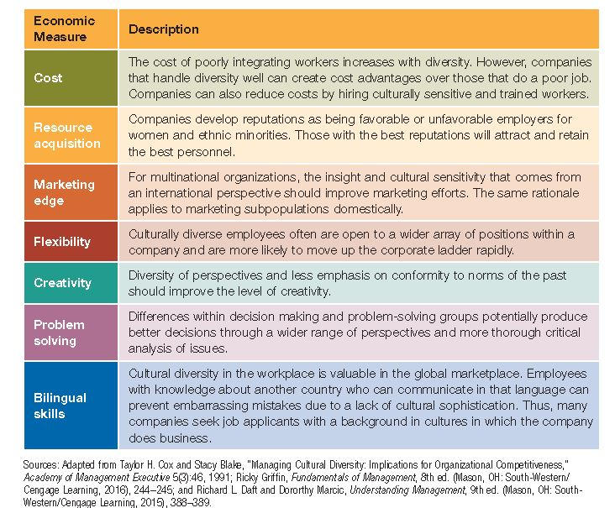
Advantages of Cultural Diversity
How would organizations benefit from encouraging cultural diversity within the organization?

Slide 14
Job Analysis
A systematic procedure for studying jobs to determine their various elements and requirements
Job description
  A list of the elements that make up a particular job
  Duties, responsibilities, working conditions, the tools and equipment used on the job
Job specification
  A list of the qualifications required to perform a particular job
  Skills, abilities, education, and experience

Slide 15
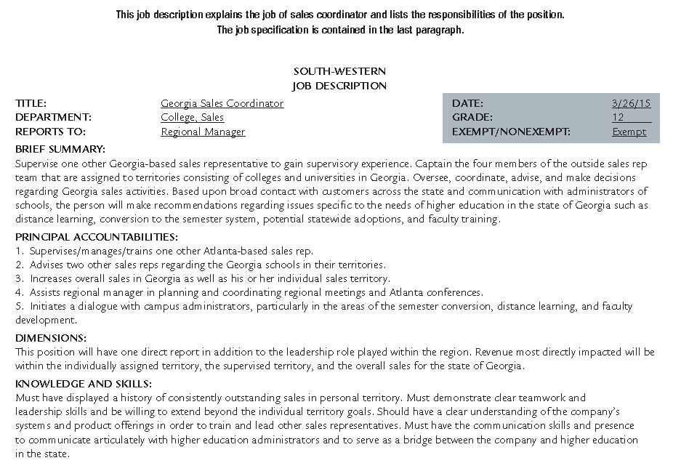
Job Description and Job Specification

Slide 16
Recruiting
Recruiting is the process of attracting qualified job applicants
Goal is to attract the “right” number of applicants
External recruiting is the attempt to attract job applicants from outside an organization
  Advantages
    Brings fresh perspectives to the company
    Attracting applicants with the required skills and knowledge
  Disadvantages
    May be expensive
    May cause resentment among existing employees
Notes:
Additional Resources:
Read about new trends in recruiting at: http://thenextweb.com/entrepreneur/2012/11/04/the-future-of-recruiting-in-the-technology-industry/

Slide 17

Internal Recruiting
Advantages
Motivates current employees
Helps retain quality personnel
  Disadvantages
  Cost of filling the vacant position
  Cost of training another
  employee

Slide 18
Selection
The process of gathering information about applicants and then using that information to choose the most appropriate applicant
Employment Applications
Assessment Centers
Employment Tests
Interviews
References

Slide 19

Orientation
The process of acquainting new employees with an organization
May be brief and informal or long and formal

Slide 20
Compensation Decisions
Compensation: The payment employees receive in return for their labor
Compensation system: The policies and strategies that determine employee compensation
Wage survey: A collection of data on prevailing wage rates within an industry or a geographic area
Job evaluation: The process of determining the relative worth of the various jobs within a firm
Notes:
Additional Resources:
How does compensation impact performance? Watch a video that explores this question: http://www.youtube.com/watch?v=dgKKPQiRRag

Slide 21
Designing an Effective
Compensation System
Designing an effective compensation system requires three separate management decisions
  Wage Level: The firm’s choice to position its general level of pay at, above, or below the market wage for an industry or a geographic area
  Wage Structure: The internal compensation structure that sets the relative pay levels for all the positions in the firm
  Individual Wages: The specific payments individual employees receive

Slide 22

Comparable Worth
A concept that seeks equal compensation for jobs requiring about the same level of education, training, and skills
Notes:
Additional resources:
Watch a video on the challenges and solutions related to comparable worth at http://www.youtube.com/watch?v=VeraE8NhOIM

Slide 23
Class Exercise
You are an administrative assistant to the human resources manager for a manufacturing firm. Your firm has 300 employees. The human resources manager asks you to research the firm’s wage policy regarding the 230 employees paid on an hourly basis.
  How would you determine the firm’s wage level when compared to other firms in your geographic area?
  In what ways could you determine the firm’s wage structure within the firm?
  How can you evaluate the individual wages paid to each of the 230 workers paid on an hourly basis?

Slide 24
Types of Compensation
Compensation can take a variety of forms:
  Hourly wage
  Weekly or monthly salary
  Commissions
  Incentive payments
  Lump-sum salary increases
  Profit sharing

Slide 25
Employee Benefits
Rewards in addition to regular compensation that are provided indirectly to employees
Pay for time not worked
Other unusual benefits
Company cafeterias
Health, life, and dental insurance
Stock-option plans
Pension and retirement programs
Tuition-reimbursement plans
Workers’ compensation insurance
Child-care services
Unemployment insurance

Slide 26
Employee Benefits
Rewards in addition to regular compensation that are provided indirectly to the employee
Types of benefits
  Pay for time not worked
    Vacation time, holidays, and sick leave
  Insurance packages
    Health, life, and dental insurance
  Pension and Retirement programs
    Costs may be shared or fully paid by the employer
  Required by law
    Workers’ compensation, unemployment insurance, and Social Security
  Other benefits
    Tuition-reimbursement, credit unions, child care, company cafeterias, exercise rooms, stock-options, special benefits to U.S. military reservists called to active duty

Slide 27
Flexible Benefit Plans
A compensation plan whereby an employee receives a predetermined amount of benefit dollars to spend on a package of benefits he or she has selected to meet individual needs
Disadvantages
High costs to administer the plans
Advantages
Allow companies to meet diverse employee needs
Help the organization be perceived as employee-friendly
Can help companies contain costs in the long run

Slide 28
Training and Development
Employee training is the process of teaching operations and technical employees how to do their present jobs more effectively and efficiently
Management development is the process of preparing managers and other professionals to assume increased responsibility in both present and future positions

Slide 29

Analysis of Training Needs
Ask:
Is training needed?
What types of training are needed?
Is it motivation rather than training that is lacking?

Slide 30

Training and Development Methods
On-the-job methods
Simulations
Classroom teaching and lectures
Conferences and seminars
Role-playing
e-Learning

Slide 31
Class Exercise
As the human resources manager for a luxury hotel, you are responsible for training and development for the hotel employees. You need to create training programs tailored to the needs of the various departments in the hotel: Housekeeping, Customer Relations, Events, Food & Beverage—as well as for the hotel management. Using the steps below, outline the various training programs required.
  Analyze the need for a program
  Determine training and development
  methods to be used
  Create an evaluation system to
  assess the program’s effectiveness

Slide 32
Performance Appraisal
The evaluation of employees’ current and potential levels of performance to allow managers to make unbiased human resources decisions
Uses:
  Lets workers know how they are doing and how they can do better
  Provides the basis for distributing rewards
  Helps the organization monitor employee selection, training, and development activities
Notes:
Additional Resources:
Watch a video on the keys to effective performance appraisals http://www.youtube.com/watch?v=BqVBDXqf2vk

Slide 33
Class Exercise
Read about the most common performance appraisal errors at the link below:
http://onlinesurvey.surveyshack.com/blog/bid/35060/The-5-Biggest-Performance-Appraisal-Errors
Draw up a list of recommendations to help managers avoid these common errors when evaluating employee performance.

Slide 34
Common Evaluation Techniques
Objective methods
  Use some measurable quantity as the basis for assessing performance
  Units of output, dollar volume of sales, number of defective products, and number of insurance claims processed are all objective, measurable quantities
Judgmental methods
  Are used more frequently
  Require that the manager judge the employee’s performance method
  Based on employee’s ranking or rating scale
Notes:
Internet Resources:
Watch videos about various performance appraisal techniques and feedback approaches at http://www.youtube.com/
Having the Performance Evaluation Discussion: http://www.youtube.com/watch?v=Y3UETIwTy70
The Importance of Performance Ratings http://www.youtube.com/watch?v=YE6zqBAYQr0
How to Give Constructive Criticism http://www.youtube.com/watch?v=fbp-zwNp-qg

Slide 35
Performance Feedback
Information provided to an employee in discussions after an appraisal is called performance feedback; the process is known as a performance feedback interview
Approaches to performance feedback interviews:
  Tell-and-sell
  Tell-and-listen
  Problem solving
  Mixed interview
  360-degree evaluation

Slide 36
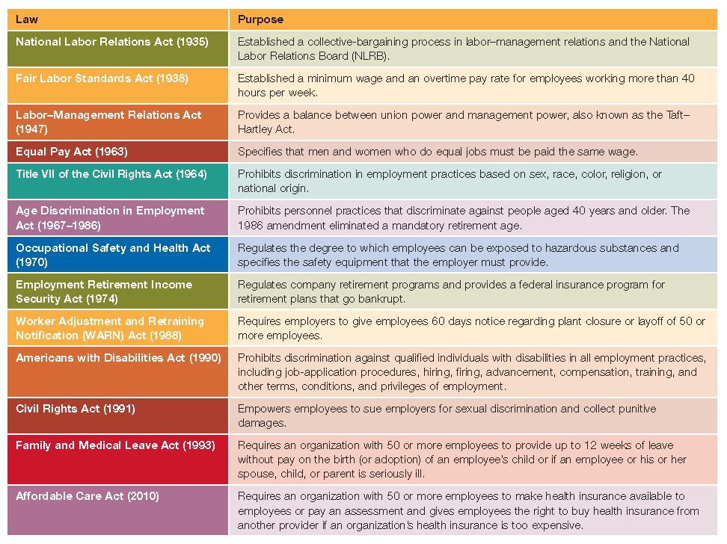
The Legal Environment of HRM

Slide 37
National Labor Relations Act and
Labor–Management Relations Act
National Labor Relations Act (1935)
  Established a collective-bargaining process in labor–management relations and the National Labor Relations Board (NLRB)
Labor–Management Relations Act (1947)
  Provides a balance between union power and management power
  Also known as the Taft–Hartley Act

Slide 38
Fair Labor Standards Act and Equal Pay Act
Fair Labor Standards Act (1938)
  Established a minimum wage and an overtime pay rate for employees working more than forty hours per week
  Exemptions: Managers and professionals
Equal Pay Act (1963)
  Specifies that men and women who do equal jobs must be paid the same wage; differences only legal if due to seniority, qualifications, or performance

Slide 39
Civil Rights Acts and
Age Discrimination in Employment Act
Title VII of the Civil Rights Act (1964)
  Prohibits discrimination in employment practices based on sex, race, color, religion, or national origin
Civil Rights Act (1991)
  Facilitates employees’ suing employers for sexual discrimination and collecting punitive damages
Age Discrimination in Employment Act (1967–1986)
  Prohibits personnel practices that discriminate against people aged 40 and older

Slide 40
Occupational Safety and Health Act and
Employee Retirement Income Act
Occupational Safety and Health Act (1970)
  Regulates the degree to which employees can be exposed to hazardous substances and specifies the safety equipment that the employer must provide
Employee Retirement Income Act (1974)
  Regulates company retirement programs and provides a federal insurance program for retirement plans that go bankrupt

Slide 41
Affirmative Action
A series of executive orders issued by the President of the United States
Applies to all employers with 50 or more employees holding federal contracts in excess of $50,000
Prescribes that employers:
  Actively encourage job applications from members of minority groups
  Hire qualified employees from minority groups who are not fully represented in their organizations

Slide 42
Americans with Disabilities Act
Americans with Disabilities Act (1990)
  Prohibits discrimination against qualified individuals with disabilities
  Requires employers to provide employees with reasonable accommodation (any modification or adjustment to a job or work environment to enable a qualified, disabled employee to perform a central job function)
  Consider:
  How do employers decide what constitutes a reasonable accommodation for a disabled employee?
Notes:
Additional Resources:
Read more about the ambiguities of reasonable accommodation in What Isn't a Reasonable Accommodation? at http://www.workforce.com/article/20130109/BLOGS07/130109989/what-isnt-a-reasonable-accommodation

Slide 43
Class Exercise
Discuss the contrasting viewpoints on affirmative action policies expressed in the following articles:
“Affirmative Action vs. White Privilege” at
http://www.ebony.com/news-views/affirmative-action-vs-white-privilege-119#axzz2Kano5YXj
“Race and College Admissions, Facing a New Test by Justices” at http://www.nytimes.com/2012/10/09/us/supreme-court-to-hear-case-on-affirmative-action.html?pagewanted=all&_r=1&
“Affirmative action: Good or harmful?” at inamerica.blogs.cnn.com/2012/10/10/affirmative-action-good-or-harmful/

